Slide 1
Sorting
Jiexin Wang
School of Software Engineering
South China University of Technology

Slide 2
O(NlogN) Sorting Algorithms

Slide 3
Heap Sort
We use a Max-Heap
Root node = A[1]
Children of A[i] = A[2i], A[2i+1]
Keep track of current size N (number of nodes)
value
7
5
6
2
4
index
1
2
3
4
5
6
7
8
N = 5
7
5
6
2
4

Slide 4
Using Binary Heaps for Sorting
Build a max-heap
Do N DeleteMax operations and store each Max element as it comes out of the heap
Data comes out in largest to smallest order
Where can we put the elements as they are removed from the heap?
Build
Max-heap
DeleteMax
7
6
5
6
5
4
2
4
2
7

Slide 5
1 Removal = 1 Addition
Every time we do a DeleteMax, the heap gets smaller by one node, and we have one more node to store
  Store the data at the end of the heap array
  Not "in the heap" but it is in the heap array
value
6
5
4
2
7
index
1
2
3
4
5
6
7 8
N = 4
6
5
4
2
7

Slide 6
Repeated DeleteMax
5
2
4
6
7
1
2
3
4
5
6
7 8
N = 3
5
2
4
6
7
4
2
5
6
7
1
2
3
4
5
6
7 8
N = 2
4
2
5
6
7

Slide 7
Heap Sort is In-place
After all the DeleteMaxs, the heap is gone but the array is full and is in sorted order
value
2
4
5
6
7
index
1
2
3
4
5
6
7
8
N = 0
2
4
5
6
7

Slide 8
Heapsort: Analysis
Running time
  time to build max-heap is O(N)
  time for N DeleteMax operations is N O(log N)
  total time is O(N log N)
Can also show that running time is Ω(N log N) for some inputs,
  so worst case is Θ(N log N)
  Average case running time is also O(N log N)
Heapsort is in-place but not stable (why?)

Slide 9
“Divide and Conquer”
Very important strategy in computer science:
  Divide problem into smaller parts
  Independently solve the parts
  Combine these solutions to get overall solution
Idea 1: Divide array into two halves, recursively sort left and right halves, then merge two halves → Mergesort
Idea 2 : Partition array into items that are “small” and items that are “large”, then recursively sort the two sets → Quicksort

Slide 10
MergeSort
Divide it in two at the midpoint
Conquer each side in turn (by recursively sorting)
Merge two halves together
8
2
9
4
5
3
1
6

Slide 11
Mergesort Example
8
2
9
4
5
3
1
6
Divide
8 2 9 4
5 3 1 6
Divide
8 2
9 4
5 3
1 6
Divide
1 element
8 2 9 4 5 3 1 6
Merge
2 8 4 9 3 5 1 6
Merge
2 4 8 9 1 3 5 6
Merge
1 2 3 4 5 6 8 9

Slide 12
Auxiliary Array
The merging requires an auxiliary array.
2
4
8
9
1
3
5
6
1
2
3
4
5
6
Auxiliary array

Slide 13
Merging
i
j
normal
target
copy
i
j
Left completed
first
target

Slide 14
Merging
①
②
i
j
Right completed
first
target

Slide 15
Merging Algorithm
/**
* pseudo code for Merging Algorithm in MergeSort
**/
Merge(A[], T[] : integer array, left, right : integer) {
mid, i, j, k, l, target : integer;
mid := (right + left)/2;
i := left; j := mid + 1; target := left;
while i < mid and j < right do
if A[i] < A[j] then T[target] := A[i] ; i:= i + 1;
else T[target] := A[j]; j := j + 1;
target := target + 1;
if i > mid then //left completed//
for k := left to target-1 do A[k] := T[k];
if j > right then //right completed//
k : = mid; l := right;
while k > i do A[l] := A[k]; k := k-1; l := l-1;
for k := left to target-1 do A[k] := T[k];
}

Slide 16
Recursive Mergesort
/**
* Recursive implementation for Mergesort
**/
Mergesort(A[], T[] : integer array, left, right : integer) : {
if left < right then
mid := (left + right)/2;
Mergesort(A,T,left,mid);
Mergesort(A,T,mid+1,right);
Merge(A,T,left,right);
}
//Driver
MainMergesort(A[1..n]: integer array, n : integer) : {
T[1..n]: integer array;
Mergesort[A,T,1,n];
}

Slide 17
Mergesort Analysis
Let T(N) be the running time for an array of N elements
Mergesort divides array in half and calls itself on the two halves. After returning, it merges both halves using a temporary array
Each recursive call takes T(N/2) and merging takes O(N)

Slide 18
Mergesort Recurrence Relation
The recurrence relation for T(N) is:
  T(1) < a
    base case: 1 element array → constant time
  T(N) < 2T(N/2) + bN
    Sorting N elements takes
      the time to sort the left half
      plus the time to sort the right half
      plus an O(N) time to merge the two halves
How to calculate T(N) ?

Slide 19
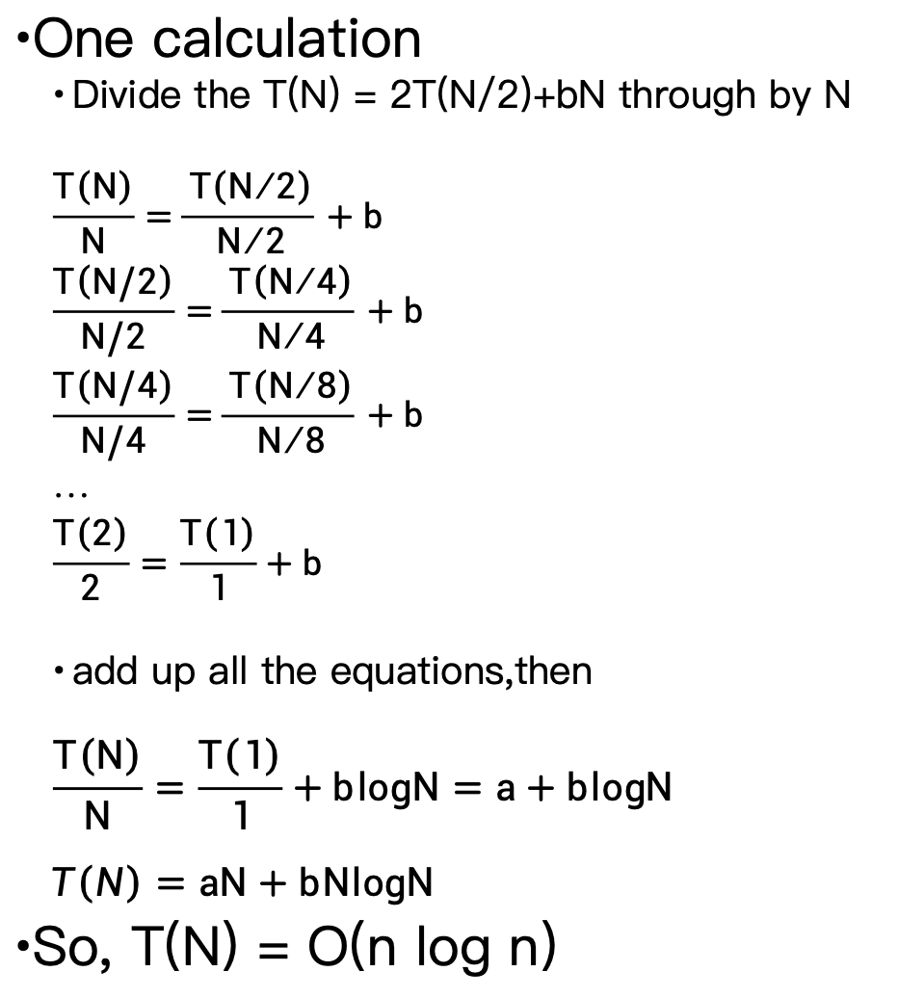
Mergesort Analysis
One calculation
  Divide the T(N) = 2T(N/2)+bN through by N
  $$\frac{T\left(N\right)}{N}=\frac{T\left(N/2\right)}{N/2}+b$$
  $$\frac{T\left(N/2\right)}{N/2}=\frac{T\left(N/4\right)}{N/4}+b$$
  $$\frac{T\left(N/4\right)}{N/4}=\frac{T\left(N/8\right)}{N/8}+b$$
  …
  $$\frac{T\left(2\right)}{2}=\frac{T\left(1\right)}{1}+b$$
  add up all the equations,then
  $$\frac{T\left(N\right)}{N}=\frac{T\left(1\right)}{1}+blogN=a+blogN$$
$$T\left(N\right)=aN+bNlogN$$
So, T(N) = O(n log n)

Slide 20
Properties of Mergesort
Not in-place
  Requires an auxiliary array (O(n) extra space)
Stable
  Make sure that left is sent to target on equal values.

Slide 21
Quicksort
Quicksort uses a divide and conquer strategy, but does not require the O(N) extra space that MergeSort does
  Partition array into left and right sub-arrays
    Choose an element of the array, called pivot
    the elements in left sub-array are all less than pivot
    elements in right sub-array are all greater than pivot
  Recursively sort left and right sub-arrays
  Concatenate left and right sub-arrays in O(1) time

Slide 22
“Four easy steps”
To sort an array S
  1. If the number of elements in S is 0 or 1, then return. The array is sorted.
  2. Pick an element v in S. This is the pivot value.
  3. Partition S-{v} into two disjoint subsets, S₁ = {all values x≤v}, and S₂ = {all values x≥v}.
  4. Return QuickSort(S₁), v, QuickSort(S₂)

Slide 23
The steps of QuickSort
S
13
81
43
31
57
75
select pivot
92
65
26
0
S₁
S₂
0
43
31
75
partition S
13
65
81
26
57
92
S₁
S₂
QuickSort(S₁) &
QuickSort(S₂)
0
13
26
31
43
57
65
75
81
92
S
0
13
26
31
43
57
65
75
81
92
S is sorted

Slide 24
Partitioning
Picking the pivot
  want a value that will cause |S₁| and |S₂| to be non-zero, and close to equal in size if possible
Partitioning Strategy
  How do the elements get to the correct partition

Slide 25
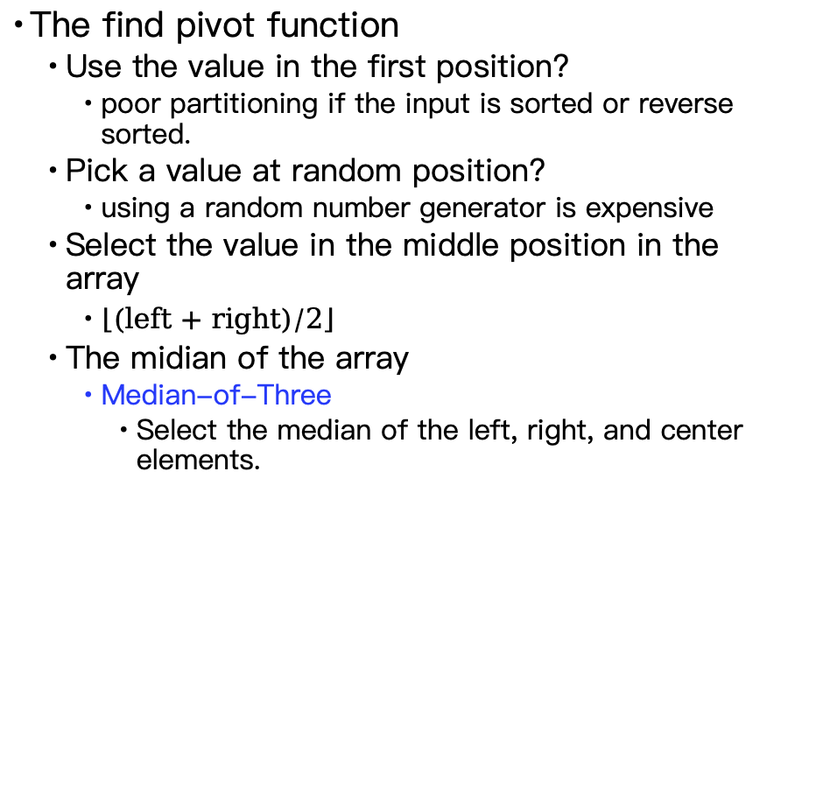
Select pivot
The find pivot function
  Use the value in the first position?
    poor partitioning if the input is sorted or reverse sorted.
  Pick a value at random position?
    using a random number generator is expensive
  Select the value in the middle position in the array
    $\left\lfloor \text{(}\text{left}\text{ + }\text{right}\text{)/}\text{2}\right\rfloor$
  The midian of the array
    Median-of-Three
      Select the median of the left, right, and center elements.

Slide 26
Partitioning Strategy
Several partitioning strategies used in practice
  Digging and filling
  3-way partitioning
  ……
  2-way partitioning (we discuss)

Slide 27
2-way partitioning
  Set pointers i and j to start and end of array
  Increment i until you hit element A[i] > pivot
  Decrement j until you hit element A[j] < pivot
  Swap A[i] and A[j]
  Repeat until i and j cross
  Swap pivot (at A[N-1]) with A[i]

Slide 28
Example
0
1
2
3
4
5
6
7
8
9
8
1
4
9
6
3
5
2
7
0
Choose the pivot using Median-of-Three
8
1
4
9
0
3
5
2
7
6
l
r
Swap the pivot with last element A[N-1].

Slide 29
Example
8
1
4
9
0
3
5
2
7
6
l
r
  Increment i until you hit element A[i] > pivot
8
1
4
9
0
3
5
2
7
6
l
r
  Decrement j until you hit element A[j] < pivot
8
1
4
9
0
3
5
2
7
6
l
r
  Swap A[i] and A[j]
2
1
4
9
0
3
5
8
7
6
l
r

Slide 30
Example
2
1
4
9
0
3
5
8
7
6
l
r
2
1
4
9
0
3
5
8
7
6
l
r
2
1
4
5
0
3
9
8
7
6
l
r
2
1
4
5
0
3
9
8
7
6
r
l
Cross-over l > r
2
1
4
5
0
3
6
8
7
9
S₁ < pivot
pivot
S₂ > pivot

Slide 31
Quicksort
//QuickSort
template <typename E, typename Comp>
void quickSort(E A[], int i, int j) {
if (j <= i) return; //List with 0 or 1 element
int pivotindex = findpivot(A, i, j); //get pivot
swap(A, pivotindex, j); //Put pivot at end
//k will be the 1st position on right side
int k = partition<E,Comp>(A, i-1, j, A[j]);
swap(A, k, j); // Put pivot in place
quickSort<E,Comp>(A, i, k-1); //Recursively
quickSort<E,Comp>(A, k+1, j);
}

Slide 32
Quicksort
template <typename E, typename Comp>
int partition(E A[], int l, int r, E& pivot) {
do {
//Move the bounds inward until they meet
//Move l right and r left
while (Comp::prior(A[++l], pivot));
while ((l<r) && Comp::prior(A[--r],pivot));
// Swap out-of-place values
swap(A, l, r);
} while (l < r); // Stop when they cross
swap(A, l, r); // Reverse last swap
return l; //Return 1st position in right part
}

Slide 33
Optimizations
Quicksort has more overhead for small arrays.
  A good cutoff range is 10.(Empirical threshold)
  Using insertion sort for small arrays.
Reduce recursive calls

Slide 34
Analysis of Quicksort
Assuming a random pivot and no cutoff for small arrays.
  T(0) = T(1) = O(1)
    constant time if 0 or 1 element
  For N > 1, 2 recursive calls plus linear time for partitioning
  T(N) = T(i) + T(N − i − 1) + cN
Best Case
  Algorithm always chooses best pivot and splits sub-arrays in half at each recursion
  T(N) = 2T(N/2) + O(N)
    Same recurrence relation as Mergesort
  T(N) = O(N log N)

Slide 35
Analysis of Quicksort
Worst case
  Algorithm always chooses the worst pivot – one sub-array is empty at each recursion
  T(N) = T(N-1) + bN
  = T(N-2) + b(N-1) + bN
  = T(1) + b(1+ … (N-1)+ N)
  = O(1) + O(N²)
  T(N) = O(N²)
Fortunately, average case performance is O(N log N) (see text for proof)

Slide 36
Properties of Quicksort
Not stable because of long distance swapping.
Pure quicksort not good for small arrays.
“In-place”, but uses auxiliary storage because of recursive call (O(logN) space).
O(N logN) average case performance, but O(N²) worst case performance.

Slide 37
Folklore
“Quicksort is the best in-memory sorting algorithm.”
Truth
  Quicksort uses very few comparisons on average.
  Quicksort does have good performance in the memory hierarchy.
    Small footprint
    Good locality

Slide 38
Homework 5-2
To Implement all sorting algorithms discussed. (The mission is not homework.)
Textbook exercises 7.11, 7.12, 7.15, 7.17, 7.19, 7.20, 7.28(not required)

